Slide 1

Gateway 1
Team Fusion

Slide 2
Scenario
Where we want to measure them…
The variables we want to measure…
Fusion’s analysis
Loughborough University Campus
Light Pollution
Air Quality
“How Loughborough is environmentally affected by the influx of students during term time”
Footfall
Traffic Noise
Loughborough Town

Slide 3
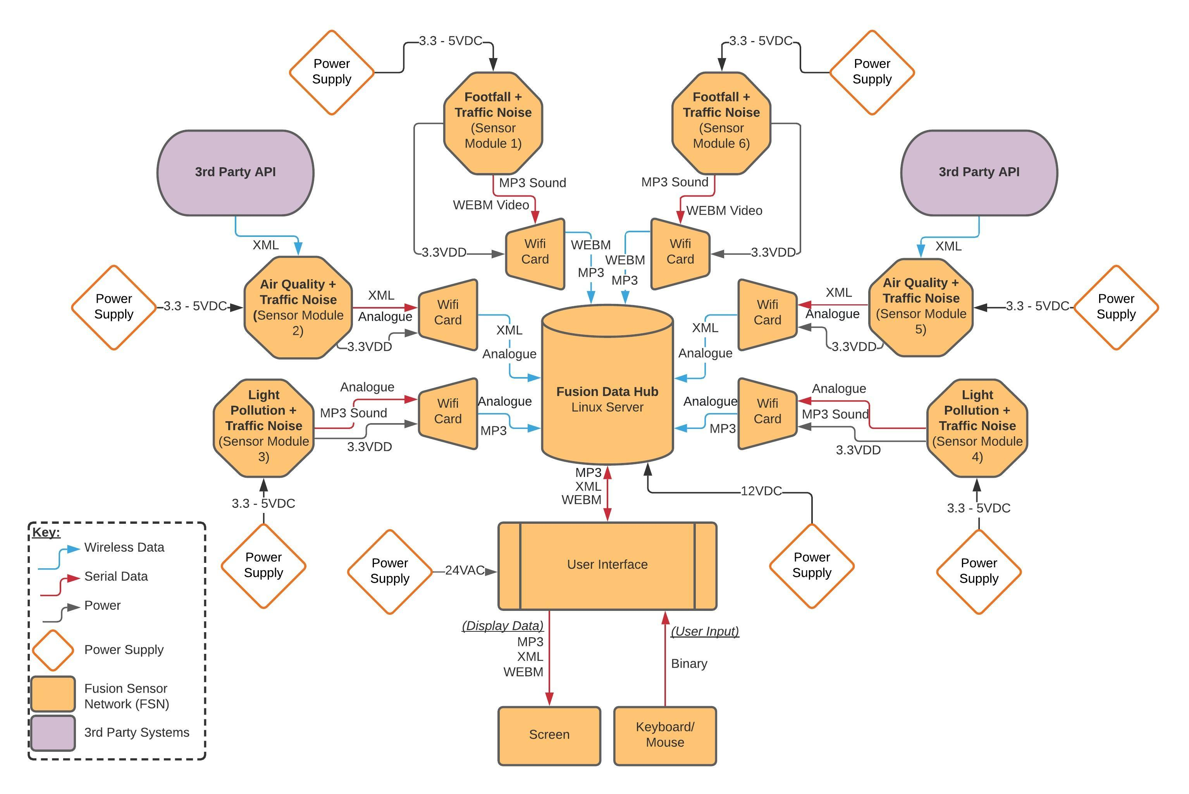
System Architecture

Slide 4
Budget
At risk of ineffectively using the whole budget, Fusion have the following questions/ reservations:
How many Sensors and Microcontrollers are needed to achieve the FSN’s base functionality?
How are we going to power externally-fitted sensors/ which power supply types need to be purchased?
How many power supplies need to be purchased?
If the Fusion’s local server/ Data Hub doesn’t offer enough storage capacity, do we need to purchase additional storage?
How is Fusion going to protect externally-fitted sensors – do we need to buy/ make enclosures?
£200
Variable Budget
Fusion has a variable budget of £200.
We believe the full budget should cover us for the purchase of additional components contributing to the FSN’s Functionality and Performance.
System Functionality:
Purchase of additional Sensors
Purchase of additional Microcontrollers
System Performance:
Purchase of External Power Supplies
Purchase of additional Storage Devices
The purchase or manufacture of protected sensor enclosures

Slide 5
Testing Report and Ongoing Plan
Fusion are aiming to run system testing against the System Requirements Document.
Scrum Meetings
Doing this has the following benefits:
Offer us a way to prove compliance to the requirements through running the validation tests
It will allow us to have a structured testing process at the both the System and Sub-system levels.
System Delivery
Test/ Development
FSN Data Analysis
Project Planning
Sprint Review
Sensor Integration
Sprint Planning
Project Start
Project End
Fusion have chosen to adopt the Systems Engineering Agile Framework for the ongoing project plan.

Slide 6
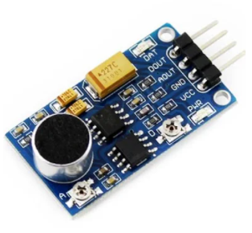
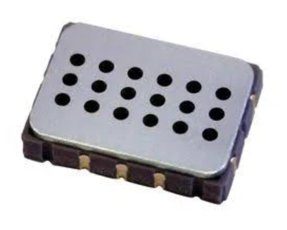
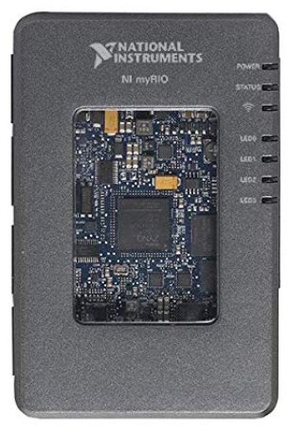
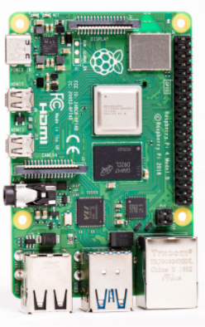
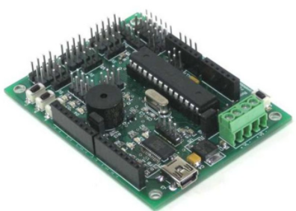
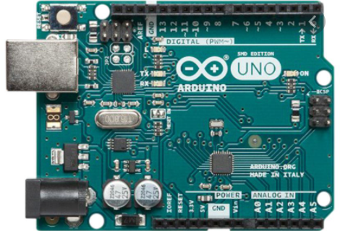
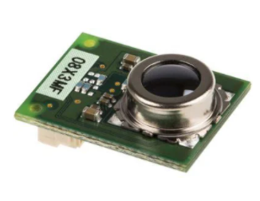
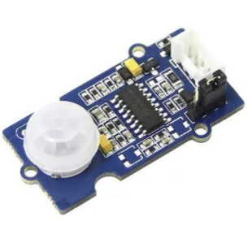
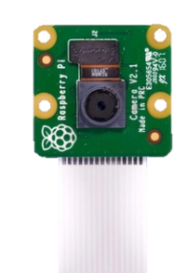
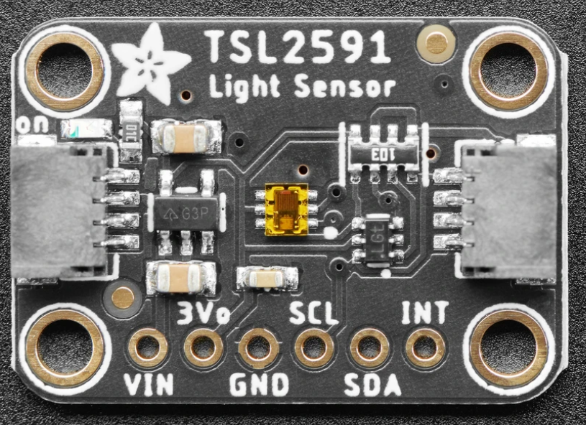
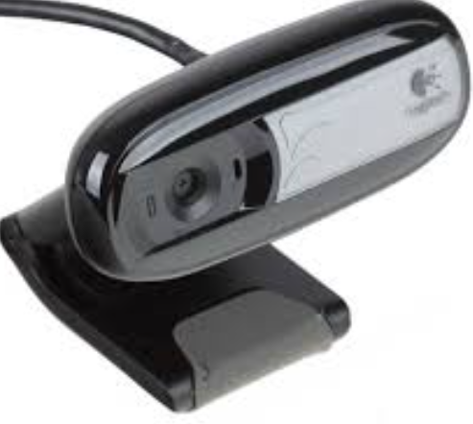
Can the base kit meet our scenario?
Sensors needed to achieve scenario’s scope:
Air Quality
Traffic Noise
What we have:
Microprocessors:
(Nitrogen Dioxide Sensor)
(Noise Sensor)
Footfall
x2
x4
(NI MyRIO)
(Raspberry Pi variations)
(Arduino Uno)
(Borboarduino)
(Thermal Proximity Sensor)
(Passive Infra Red Motion Sensor)
Data Recording devices:
Light Pollution
Note, this is an initial set of sensors we may require after conducting research into industrial sensors…
x2
(Luminosity (Lux) Sensor)
(Logitech Camera)
(Raspbery Pi Camera Module V2)

Slide 7
Current gaps in knowledge and literature
Fusion have the following knowledge gaps with regard to the operation and maintenance of the Fusion Sensor Network:
Sensor Sampling Frequency
Sensor communication
Data Processing
Power Supply
Storage Capacity
Types of Power Supplies
Grouping incoming sensor data types
Distribution
Storage preservation
Does local server provide sufficient storage?
Power preservation
Fitment and Storage
Optimum frequency for sufficient data analysis
Data types
Relating data to scenario’s variables
Is portable storage required?
Frequency Ranges

Slide 8
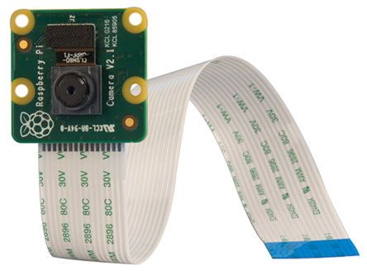
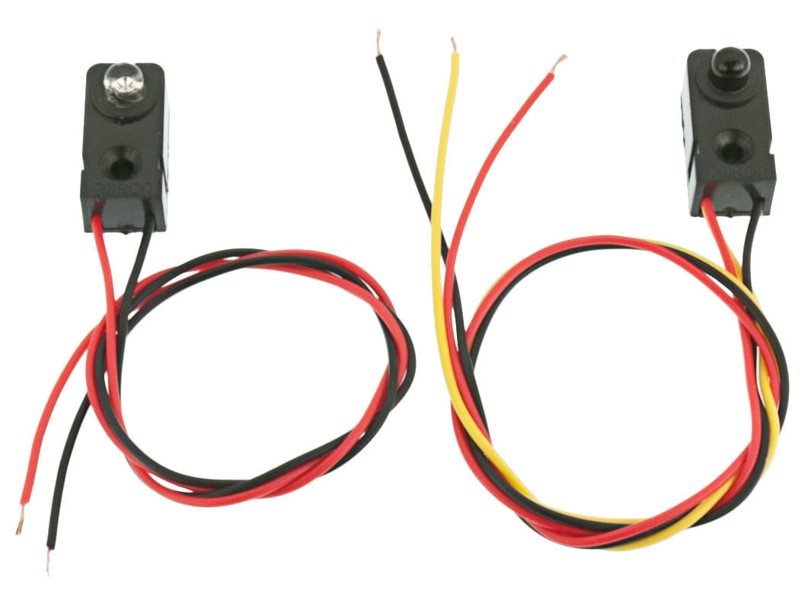
Research - Footfall
Method 1 – Using pi cameras for object detection
Individually process images of an area to provide a count of people using object detection
Appropriate application for large/open spaces
Several useful open libraries to assist in implementation of this method (OpenCV)
Requires comprehensive coding ability due to the complexity of this solution
Complexity also increases with the size of the sample area used
Research into data privacy required
Cost for addition Pi 2
cameras (if required): ≈ £20
Method 2 – Using infrared bream-beams
Use infrared beams to count people in an area each time the beam is broken
Appropriate application for small spaces such as doorways/corridors
Quick and simple to set up, requires little programming knowledge
Challenges arise from multiple people crossing the beam at once, multiple reading may be needed to guarantee accuracy of results
Cost for implementation: < £6

Slide 9
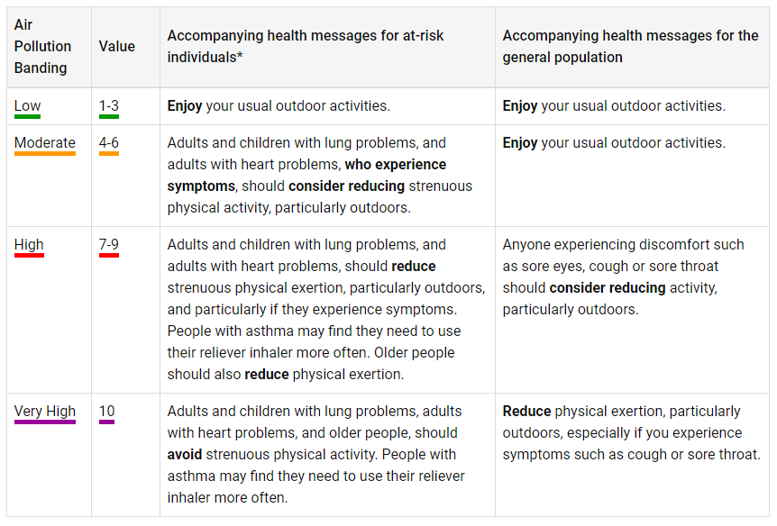
Research – Air Quality
Method – Using Air Quality Index (AQI)
The AQI is a measure of how polluted the air currently is over a given period
Used by government agencies to communicate possible health risks to the public
Different countries have different ways of categorizing air quality based on national standards. In the UK the Daily Air Quality Index (DAQI) is used
This is based on the concentrations of five pollutants: Nitrogen Dioxide; Sulphur Dioxide; Ozone; Particles< 2.5µm; Particles< 10µm
Each pollutant is given an index value between 1-10 based on the concentration (µgm-3)
Conversion values can be found gov.uk
The highest index value determines the health risk as shown in the table above
This solution would require a high volume of sensors

Slide 10
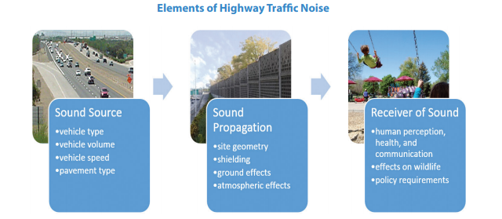
Research – Traffic Noise
ISO 5130: Standard for measurements of sound pressure (noise pollution) levels emitted by stationary road vehicles
Method – Arduino Microphone
Traffic noise dominated by 1000Hz frequencies (cars)
Slightly lower (500-1000Hz) for HGVs
Perceived traffic noise varies significantly depending on reflected surfaces
KY-038 omni-directional microphone sound sensor for Arduino
Frequency filter to isolate traffic noise within frequency range
Eliminates noise from people’s voices, music, skateboards etc
Multiple sampling stations
Experimentation with microphone height and proximity to reflective surfaces such as walls
Judith L. Rochat, Darlene Reiter, “Highway Traffic Noise” – acousticstoday.org (12/2016)

Slide 11
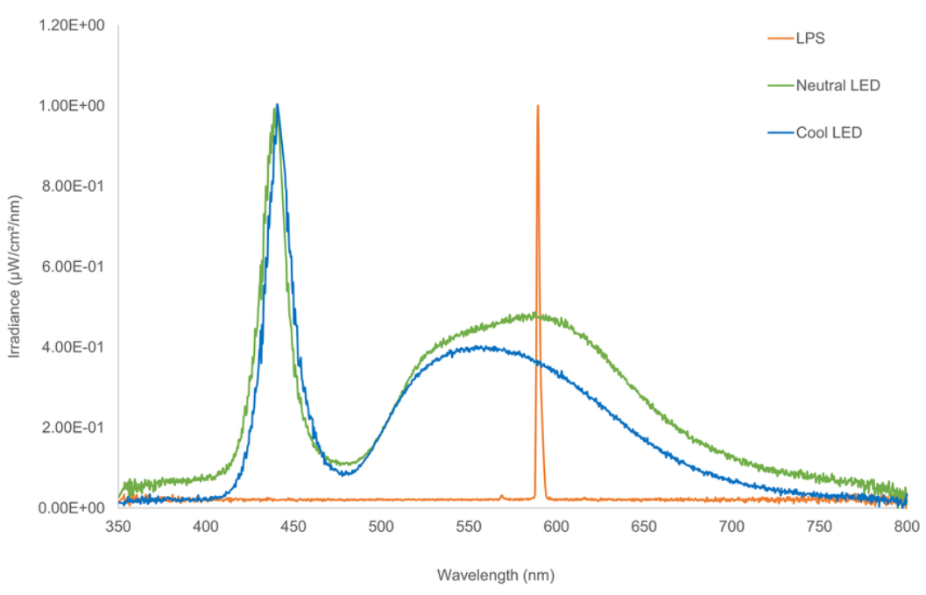
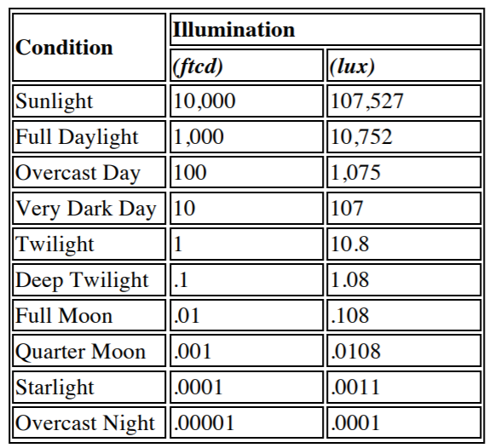
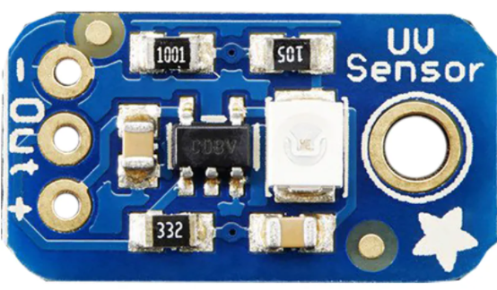
Research – Light Pollution
Method 1 – Lux Sensors
“Lux” – Luminous Flux per Unit Area; a unit used to describe illuminance.
Manufacturer “Adafruit” creates cheap COTS sensors measuring vast luminosity ranges – for example, the Adafruit TSL2591 measures a lux range of 188 uLux to 88,000 Lux; cost: £6.60
Method 2 – Ultraviolet (UV) Sensor
A photodiode is used to detect UV frequencies
A particular Adafruit UV Breakout Module can detect frequencies between 240nm – 370nm; cost: £4.95
Outdoor streetlights use Low-Pressure Sodium (LPS) and Light Emitting Diode (LED) emitting UV-A and UV-C frequencies – ranging between 350nm – 800nm (see graph below).
Common Light Levels from Outdoor Sources
NOAO.edu, n.d. Recommended Light Levels (Illuminance) For Outdoor And Indoor Venues. [online] pg.1. Available at: <https://www.noao.edu/education/QLTkit/ACTIVITY_Documents/Safety/LightLevels_outdoor+indoor.pdf>
https://uk.rs-online.com/web/p/sensor-development-tools/1245472/
Rowse, Liz & Harris, Stephen & Jones, Gareth. (2016). The Switch from Low-Pressure Sodium to Light Emitting Diodes Does Not Affect Bat Activity at Street Lights. [online] Figure 2. Available at: <https://www.researchgate.net/figure/The-spectral-output-of-LPS-and-LED-street-lights-representative-of-the-lights-used-in_fig2_299395983>
https://www.adafruit.com/product/1980

Slide 12
What next?
Fusion’s immediate (Post-GW1) plan is as follows:
Verify the Sensor Types and quantities for the measurement of all 4 of the scenario’s variables
Verify need of additional power supplies
Research 2 different power distribution methods, and incorporate into System Architecture
Obtain access to local server and establish storage capacity
Procure Sensors, Power Supplies and additional Storage as required
Begin 1st Agile Sprint Cycle
Current Date:
30/10/2020
05/10/20
18/10/20
11/01/21
26/03/21
26/04/21
10/05/21
GW1
GW2
GW3
Autumn Term
Spring Term
Summer Term
Programme Key
Project planning 12/10/20 to 06/11/20
Development (4x 3-week sprints) 06/11/20 to 22/01/21
Sensor Integration 22/01/21 to 22/03/21
FSN Data Analysis 22/03/21 to 10/05/21
System Delivery 10/05/21

Slide 13
Any Questions?

